Slide 1

Introduction to Research Data Management
Data documentation
Notes:
## Objectives
- Identify relevant project-level and data-level documentation.
- Recognize the purpose of documentation tools such as lab notebooks, codebooks, and readme files.

Slide 2
Workshops
1. Build an overview
2. Collect and document data
3. Store digital data
4. Work with data
5. Share and preserve data
6. Plan ahead

Slide 3
Introduction
Focus on documenting your data to help you
share information about your project with your advisor,
write your thesis or dissertation,
and ensure your data are useful later.
Notes:
## Introduction
In this section, we'll focus on documenting your data to help you share information about your project with your advisor, write your thesis or dissertation, and to ensure your data are useful later.
Data documentation starts during collection and continues throughout the time you work with the data, including when performing quality assurance and analysis.

Slide 4
Why document data
Documenting your data enables:
You to get a mess of details out of your head.
You to reproduce and improve workflows in the future.
Your collaborators to find the right data and use them properly.
Notes:
## Why document
It will enable:
- You to get a mess of details out of your head, so that you can focus on doing your work and avoid forgetting important considerations.
- You can reproduce and improve workflows in the future.
Other researchers, including your collaborators, to find the right data and use them properly.
Clear and detailed documentation is essential for data to be understood, interpreted, and used.
Generally, data documentation explains the
who
what
where
when
and why of data

Slide 5
Discussion
As your working on a research project, what sorts of information do you document?
How do you document that information?

Slide 6
What to document
High-level documentation explains your research goals and the progress of your project.
Low-level documentation explains the details of the data, how it has been collected, stored, and changed over time.
Notes:
## What to document
If you have experience with research, you may already have a process for documenting your data.
We’ll talk about formalizing that process a little.
The practices we discuss today build into our future conversation about sharing data and metadata standards.
Let’s start by breaking documentation down into two levels.
**High-level** documentation explains your research goals and the progress of your project. And gives an overview of your work and methods.
**Low-level** documentation explains the details of the data, how it has been collected, stored, and changed over time. This is the nitty gritty of your process.
Both of these are valuable to create and maintain throughout your research, because they will help you to recall your work and explain it to others as you get into the messy details of research.

Slide 7
Project documentation
Rationale and context for data collection.
Research questions, goals, and hypotheses.
Data sources, collection methodology, protocols.
Data validation and quality assurance actions.
Transformation of raw or derived data for integration or analysis.
Data confidentiality, access, and use conditions.
Notes:
Project documentation explains:
- Rationale and context for data collection
- Research questions/hypotheses
- Data sources, collection methodology, protocols
- Data validation and quality assurance actions
- Transformation of raw or derived data for integration or analysis
- Data confidentiality, access, and use conditions

Slide 8
Dataset documentation
Variable names and descriptions.
Codes and classification schemes.
Algorithms used to transform data.
Structure and organization of files.
Relationship among data files or tables in a database schema.
Version information.
File formats and software used.
Notes:
Dataset documentation explains:
- Variable names and descriptions
- Codes and classification schemes
- Algorithms used to transform data
- Structure and organization of files
- Relationship among data files or tables in a database schema
- Version information
- File formats and software used

Slide 9
Break

Slide 10
How to document
A few documentation tools:
Laboratory and field notebooks
README files
Codebooks
Notes:
## How to document
We’ve gone over the information that is worth documenting, and likely for you to find valuable. Now let’s talk a little about the ways in which you may want to document your project and data.
- Laboratory notebooks
- Codebooks and data dictionaries
- README and log files

Slide 11
Notebooks
Common in laboratory settings and fieldwork.
Document context, project, and dataset level information.
Give you one place to go throughout the research process.
Encourage a thoughtful examination.
Enable continuity in case of unexpected events or time passing.
Establish a legal and scientific provenance (historical record) of your work.
Notes:
### Notebooks and note files
For projects including observational and experimental data sources, lab and field notebooks are crucial components of data management. However, notebooks are also helpful to save project-level documentation when working with data from other sources.
Keeping a notebook is the most thorough method of documentation we’ll discuss, and can serve as a personal thinking tool as well as a reference.
Provide a central and physical location for protocols, results, and happenings.
You have one place to go.
This gives context when you go back to see what you were thinking one or two years ago.
Encourage a thoughtful process.
The act of writing forces you to explore and clarify ideas.
Enable continuity in the face of unexpected events or time passing.
Yes, you will forget if you don’t write it down.
Provide a record of how your data were collected, organized, and processed.
Establishing a legal and scientific provenance (historical record) of your work.

Slide 12


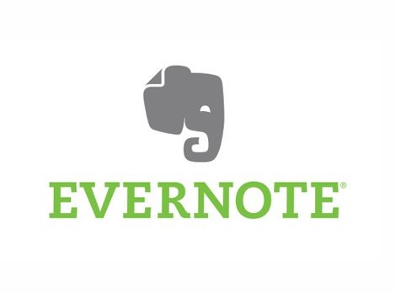

Analog and digital notes
Notes:
### Physical notebook (analog)
- stitched binding that lays flat when open
- larger size is generally better
- better quality paper and pre-numbered pages are worth it
### Digital notes
Electronic notebooks (ELNs)
You may use one of these if you work in the biological sciences, they are becoming more common in a lab setting.
SciNote
Other Computer and Mobile Software
If you primarily work alone, you may be more interested in using other note-taking software. A few examples of which I’ll go over.
OneNote
Jupiter Notebooks
Evernote
Remember the export feature. Note here are stuck in this format.
- Text files saved in a directory (harder to search)
- NVAlt

Slide 13
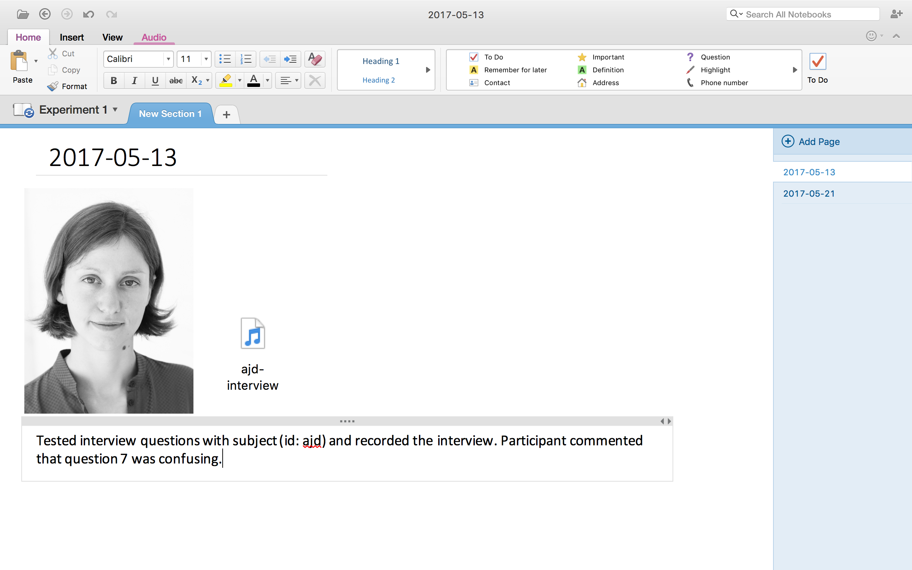
Notes:
### OneNote
Microsoft product. May be nice if your comfortable with the Microsoft office ecosystem.
Allows you to write notes and add images and other media anywhere on the page.
Organized into notebooks with sections and pages
Can be synced online
Can save notes as PDF, and may be able to share online.
But it’s worth being careful using these notebooks because they might not be the friendliest in trying to export away from Microsoft products.

Slide 14
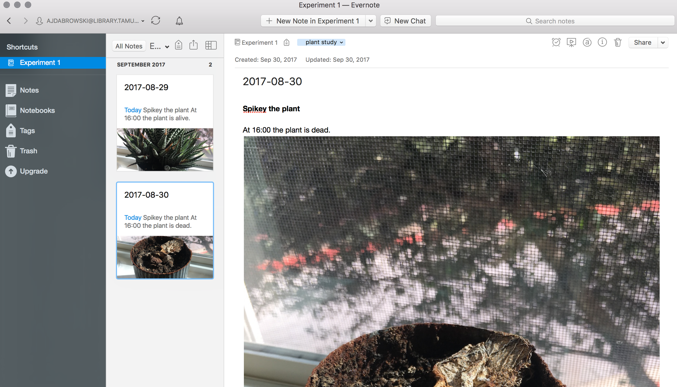
Notes:
### Evernote
Application with a free and paid option
Online and on desktop, synchronize across computers
Export webpages
Text, links, and images
Allows for organization into notebooks
Can link to other services like Google Drive.
Can share within the app, or export as HTML, save as a PDF file

Slide 15
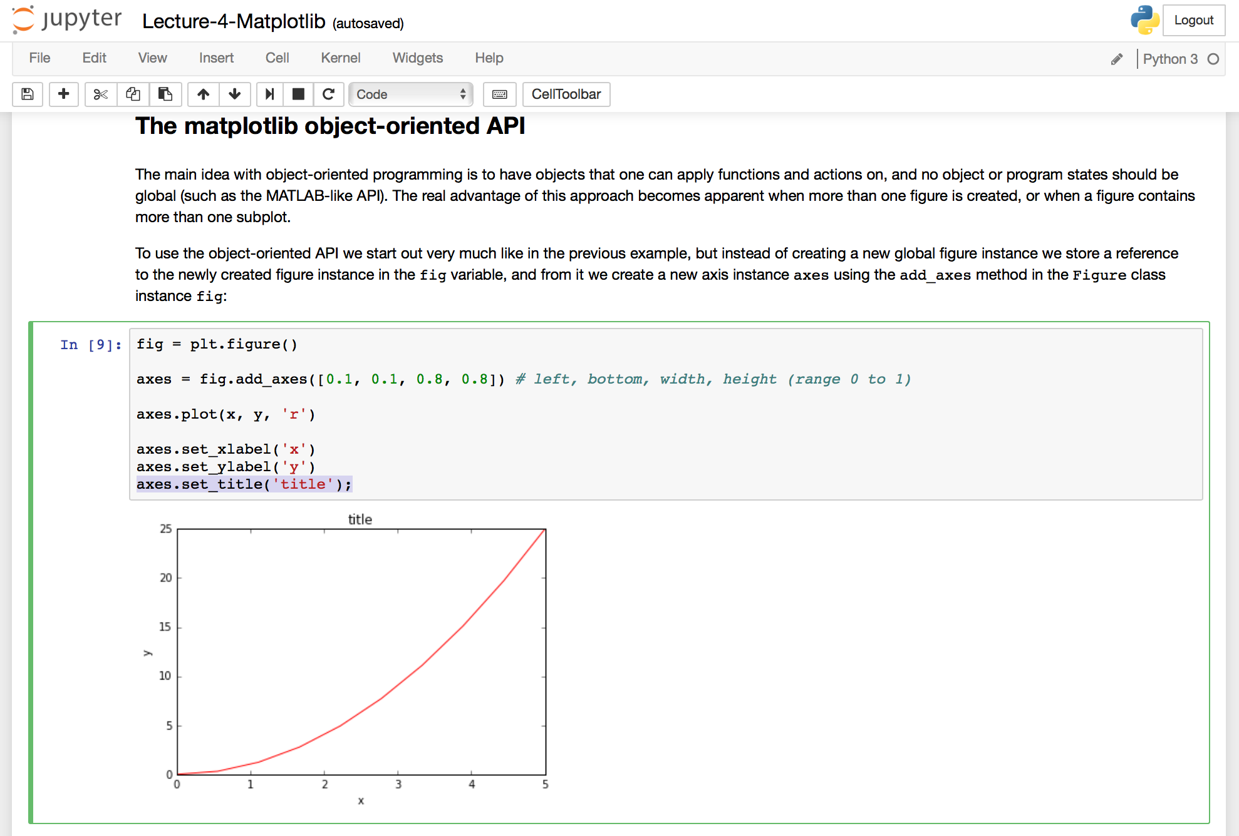
Notes:
Jupyter notebooks are worth knowing about, especially if you write code, and especially if you code in Python, but also Bash, R, MATLAB. [Website](https://github.com/jupyter/jupyter/wiki/Jupyter-kernels)
Jupyter notebook software runs locally using a browser-based tool for interactive authoring of documents. They allow you to:
Interleave executable code with explanatory text.
Execute code from the browser, with the results of computations attached to the code which generated them.
- Edit code with automatic syntax highlighting, indentation, and tab completion.
These documents are internally JSON files. Since JSON is a plain text format, they can be version-controlled and shared with colleagues.
Notebooks may be exported to a range of static formats, including HTML (for example, for blog posts), LaTeX, PDF, and slide shows.
#### Extra
Jupyter Notebook Viewers an additional service that loads the notebook document from a URL and renders it as a static web page. The results may thus be shared with a colleague, or as a public blog post, without other users needing to install the Jupyter notebook themselves.
Notebook documents: a representation of all content visible in the web application, including inputs and outputs of the computations, explanatory text, mathematics, images, and rich media representations of objects.
See also
See the installation guide on how to install the notebook and its dependencies.
Main features of the web application
• In-browser editing for code, with automatic syntax highlighting, indentation, and tab completion/introspection.
•The ability to execute code from the browser, with the results of computations attached to the code which generated them.
• Displaying the result of computation using rich media representations, such as HTML, LaTeX, PNG, SVG, etc. For example, publication-quality figures rendered by the matplotlib library, can be included inline.
Notebook documents
Notebook documents contains the inputs and outputs of a interactive session as well as additional text that accompanies the code but is not meant for execution. In this way, notebook files can serve as a complete computational record of a session, interleaving executable code with explanatory text, mathematics, and rich representations of resulting objects.
In effect, nbviewer is simply nbconvert as a web service, so you can do your own static conversions with nbconvert, without relying on nbviewer.

Slide 16
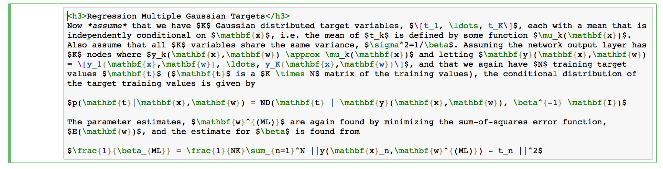
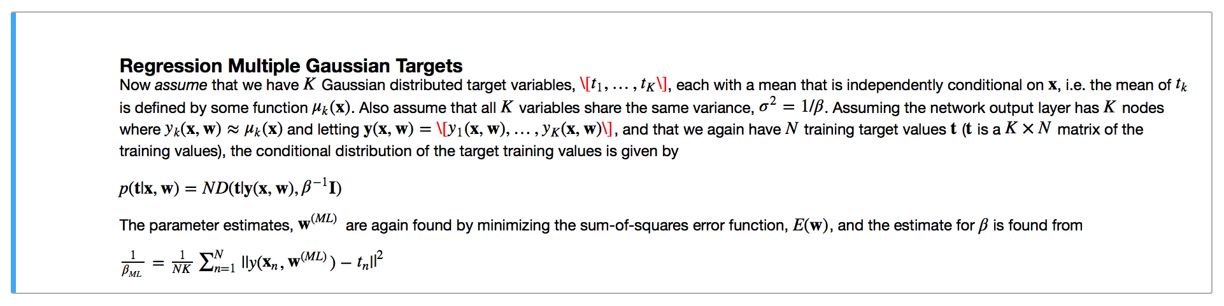
Notes:
Notebook documents: a representation of all content visible in the web application, including inputs and outputs of the computations, explanatory text, mathematics, images, and rich media representations of objects.
They allow you to write notes, add images, and format notes, as well as writing and running the code within the notebook.
Specifically a neat thing is that you can write your notes including LaTeX for mathematical expressions, and they will be formatted for you.
#### Extra
•In-browser editing for rich text, including headers, lists, and that kind of thing. This uses the Markdown markup language, and can also include HTML.
•Include mathematical notation within markdown cells using LaTeX
and rendered natively by MathJax.

Slide 17
Good practices and tips
Date each entry.
List full names and contact information for collaborators.
Take notes on meetings and discussions.
Write justifications for research methods and data source(s).
Include protocols.
Capture conditions in the field, lab, interview.
Notes:
Good practices:
- Date each entry
- Include the year
- List the full names and contact information for all collaborators
- Identify who did what
- Take notes on meetings and discussions about the research
- Write the names of people who assisted you for future acknowledgement
- Provide justifications for the method and data source(s)
- Details about where and who derived or digitized data come from
- Include protocols for experiments or data acquisition
- Capture conditions in the field, laboratory, or interview
- Include the time, using military time or include AM/PM
- Note details on experimental/research organisms/subjects
- List details like manufacturer, batch, etc. for purchased material
- Record equipment details such as settings and instrument calibration

Slide 18
Good practices and tips
Note mistakes and corrections that need to be made.
Annotate calculations with units.
Record digital file names and locations.
Describe location of physical materials.
Use images and print-outs to simplify documentation.
Notes:
- Note mistakes in detail and what needed to be fixed
- Annotate all calculations and include units
- If data are logged or added on a computer, record file names of data
- Include where they are stored and backed up
- Describe the locations of physical materials: data binders, seeds, samples, etc.
- Use images to simplify documentation
- Take photos or make quick drawings of set-ups, locations, etc.

Slide 19
README files
Coopted from software development.
Describe the files and folders in a project.
Document mainly at the dataset level.
Primarily aimed at an external audience and your future self.
Notes:
README files are another tool you can use to document your data. They are usually stand-alone plain text files within a folder and aptly named “README.txt”.
These documents are common in software development where they account for and describe the the files and folders in a project.
For data, README files are useful for outlining more detailed information about your datasets, in addition to describing the organization of the digital files and folders that contain your data. They can also contain some contextual information about the project.
They help you, or if you are sharing your data, someone else to get oriented by outlining how the data in different files connect, where files are located, and what to expect within each file.
If you use a notebook, you can extract information from the notebook and include the necessary details in the README.

Slide 20
Example: README template
Cornell University.
https://cornell.app.box.com/v/ReadmeTemplate
Notes:
README files can be free-form, or very structured, to describe the contents, structure, and layout of a data collection.
This is a structured template, to give you an idea of the type of information that is relevant.
Your own README’s don’t need to be this detailed, but you can use this as a template, to develop your own template, or simply for ideas about the information you would like to capture about your data.

Slide 21
README tips
Notes:
I recommend that you use a README.txt file at the top level of your project folder to explain the purpose of the project, the relevant summary and contact details, and general organization of your files.
This is equivalent to using the first page of your laboratory notebook to give a general description of your project.

Slide 22
Codebooks and data dictionaries
Document at the level of variables and data within the dataset.
Stand-alone or part of other files.
Primarily aimed at an external audience and your future self.
Notes:
While README files describe a collection of data and how the digital files and data within them are organized; Codebooks and data dictionaries are give a detailed description of the data at the level of each variable within a dataset.
They can be contained within a README doc.
We saw an example of this in the Cornell template within the “DATA-SPECIFIC INFORMATION FOR: [FILENAME]” section.
They can also be separate files, or even part of a data spreadsheet like the one we looked in the data collection portion.
Codebooks are commonly used in social sciences, as a document containing the list of codes used in research. A well-documented codebook "contains information intended to be complete and self-explanatory for each variable in a particular data file.”
Data dictionaries are sometimes considered less informative than a codebook, but contain the same kind of information. For the purposes of this presentation, data dictionaries and codebooks are pretty much the same thing.

Slide 23
Example: Tabular data and data dictionary
Data from the Duke Lemur Center about the weights of lemurs.
Data file: http://bit.ly/2wtIeuh
README file: http://bit.ly/2fL4UTH
Notes:
Data file: http://datadryad.org/bitstream/handle/10255/dryad.66569/DataRecord_3_DLC_Weight_File_06Jun14.csv?sequence=1
README file: http://datadryad.org/bitstream/handle/10255/dryad.66569/README.docx?sequence=2

Slide 24
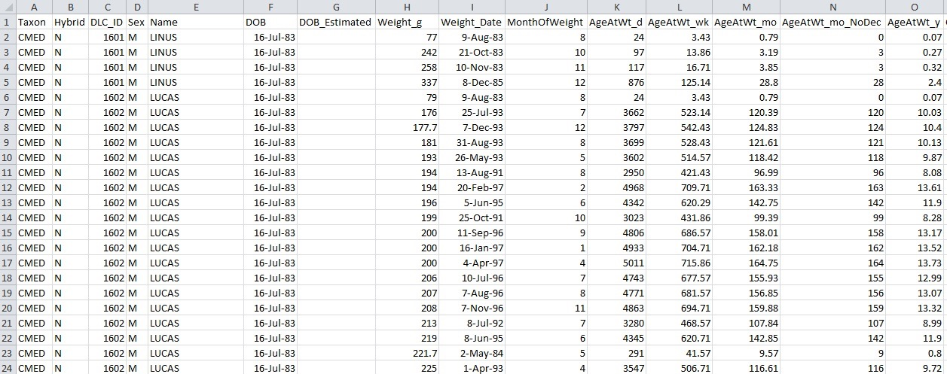
Example: Data dictionary
Notes:
Data from the Duke Lemur Center about the weight of lemurs.
The data are clean, but they cannot be interpreted from the spreadsheet alone. For example, What does the variable ‘AgeAtWt_mo_NoDec’ mean.
What does the value ‘CMED’ within the variable ‘Taxon’ mean?

Slide 25
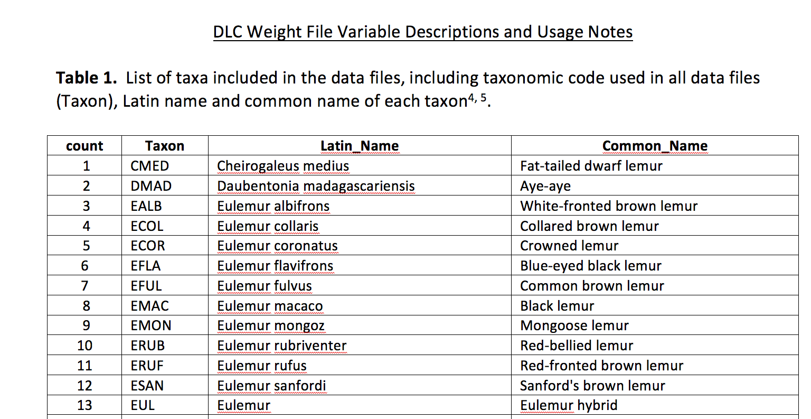
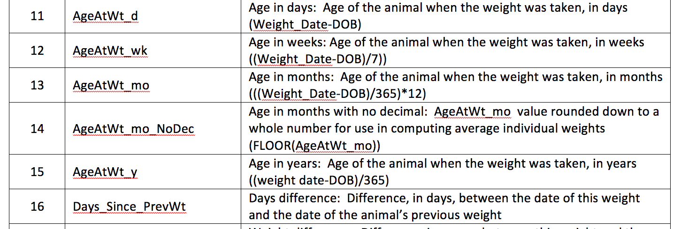
Notes:
Enter the data dictionary in the form of the README.doc file.
lays out information on each variable in the dataset. For example, it defines the variable “AgeAtWt_mo_NoDec” as
Age in months with no decimal: AgeAtWt_mo value rounded down to a whole number for use in computing average individual weights (FLOOR(AgeAtWt_mo))
it also lists the the various taxonomic codes used within the ‘taxon’ variable.
http://datadryad.org/bitstream/handle/10255/dryad.66569/DataRecord_3_DLC_Weight_File_06Jun14.csv?sequence=1
http://datadryad.org/bitstream/handle/10255/dryad.66569/README.docx?sequence=2

Slide 26
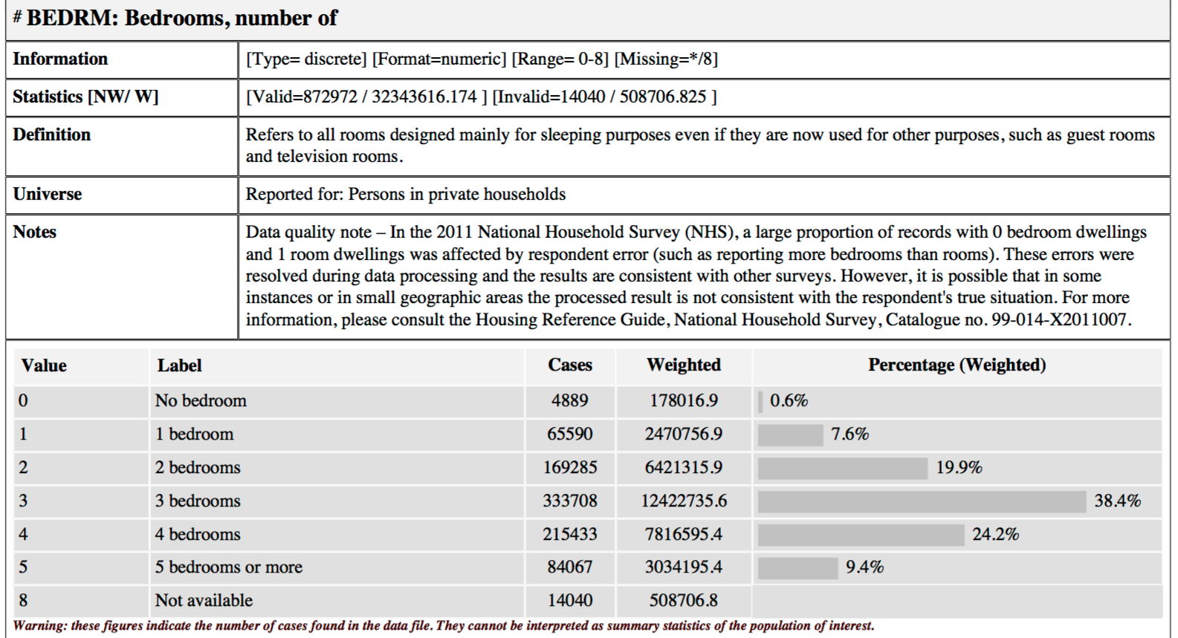
Example: Data Documentation Initiative codebook
Notes:
### DDI Codebook example
We just looked in detail as a data dictionary for a dataset about Lemurs. I’d also like to share what a more detailed codebook could look like.
This little snippet is from a codebook that uses the DDI standard. DDI stands for the Data Documentation Initiative (also known as DDI Metadata).
An international standard for describing surveys, questionnaires, statistical data files, and social sciences study-level information.
This snippet is from the documentation for a National Household Survey, 2011 [Canada]
It includes the same information as the codebook we looked at.
At the top “BEDRM” is the variable name and a definition is included.
then “value” and label” indicate the code and it’s meaning
This codebook contains more information about the variable (data quality note, statistics about the variable)

Slide 27
Good practices and tips
Variable name.
Variable meaning.
Variable format and how the variable was recorded.
Units of measurement for scale variables.
Numeric codes for categorical variables, and what they represent.
Known issues and relationships
Notes:
This list represents the types of things you would want to know when faced with an unknown dataset. And what ought to be included in a document like a codebook or data dictionary.
Name assigned to the variable
What the variable represents.
Variable format, how the variable was actually recorded in the raw data
numeric, string; how many characters wide it is; how many decimal places it has
For scale variables: The variable's units of measurement
For categorical variables: If coded numerically, the numeric codes and what they represent
Null value indicator and missing value codes
Known issues with the data (systematic errors, missing values, etc.)
Relationship to other variables

Slide 28
Conclusion
Identified relevant project-level and data-level documentation.
Reviewed documentation tools including lab notebooks, README files, and codebooks.
Notes:
## Objectives
- Identify relevant project-level and data-level documentation.
- Recognize the purpose of documentation tools such as lab notebooks, codebooks, and readme files.
If you’re working with a single dataset, a codebook may be enough. If you’re working with a set of folders and data files, a read file can be useful to explain how those files are organized.
Not only is such information incredibly useful if you’re sharing a dataset, but it’s also useful if you plan to reuse a dataset in the future or you are working with a very large dataset.
Basically, if there’s a chance you won’t remember the details or never knew them in the first place, a codebook is needed.

Slide 29
References and resources
Briney, Kristin. “Data Ab Initio” [Blog](http://dataabinitio.com/?p=378), [Blog](http://dataabinitio.com/?p=454)
Cornell University. "Guide to writing "readme" style metadata" [Webpage](https://data.research.cornell.edu/content/readme)
DDI. “Create a codebook” [Website](http://www.ddialliance.org/training/getting-started-new-content/create-a-codebook)
DMPTool "Data Management General Guidance" [Website](https://dmptool.org/dm_guidance)
Jupyter Team. “The Jupyter Notebook" [Website](http://jupyter-notebook.readthedocs.io/en/stable/notebook.html)

